Slide 1
Introduction to Data Quality
DA0022
Presented by: Bob Parry – Data Quality and Access Specialist Data and Visualization Services

Slide 2
Roadmap for Today
Step 1
STEP 4
STEP 5
Step 8
Why Does Data Quality Matter?
Dimensions of Data Quality
Sources of Anomolies
Data Quality Assessment
& Case Study
STEP 6
Critical Fields
STEP 2
STEP 3
STEP 7
Fit For Purpose
Trust in Data
Target Setting and Monitoring

Slide 3
Step 1 – Why Does Data Quality Matter?
Notes:
Title:
Font: Tw Cen MT Condensed
Font size: 60

Slide 4
Real world example
Data Quality Example – YouTube - Mistakenly Valued Ind. House Strains Budget
Property value of a house in Indiana changes from $121,900 to $400,000,000
Downstream impact: Annual property taxes due change from $1,500 to $8,000,000
Downstream implication: Budget shortfall, layoffs, cut of social programs.
Could this happen at the Region?

Slide 5
What is Quality?
Imagine you supervise a table manufacturing plant.
What elements of the table would you need to make sure meet the quality standards before you approve it for sale?
How would you ensure this?
What would you do if tables you had already sold had a problem?
Notes:
What are the consequences of bad data

Slide 6
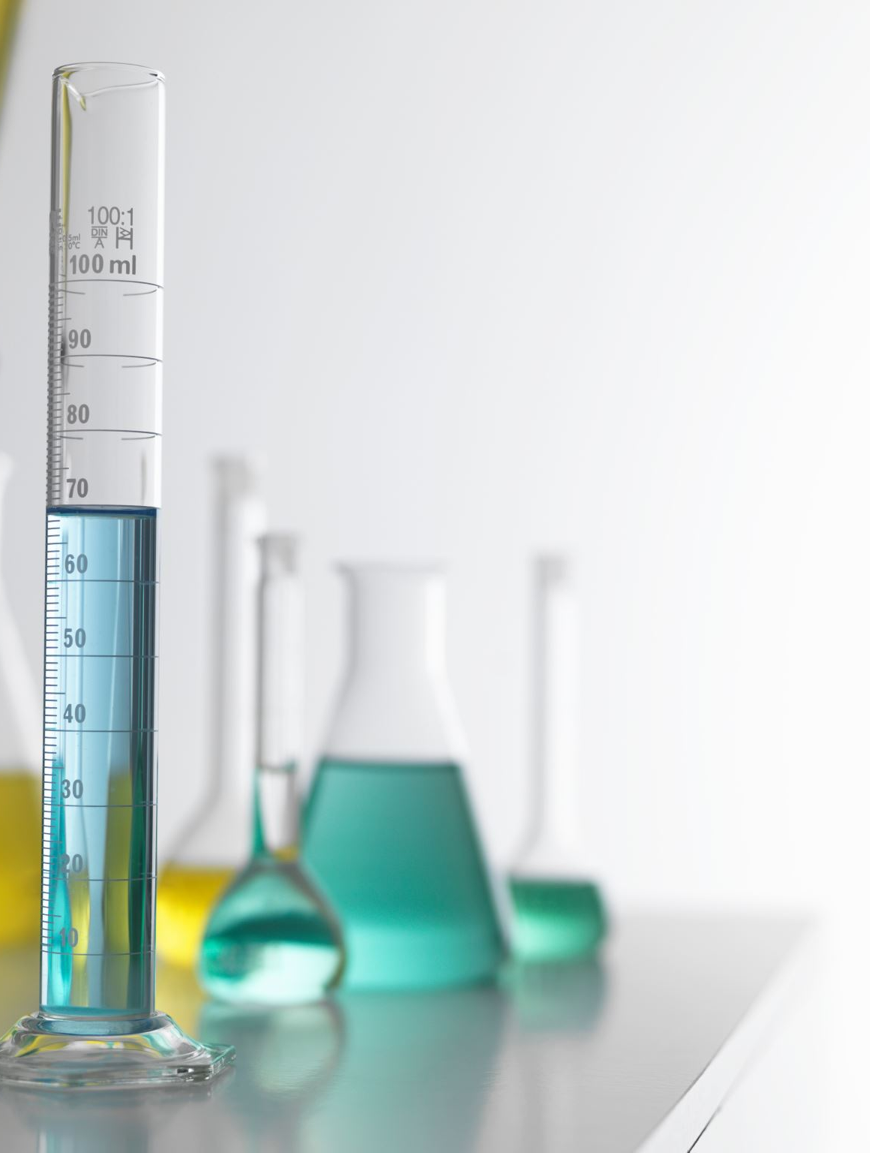
Measurement
Can you measure quality?
What is an effective measurement?
Interpretable: Users must understand what you are talking about
Reproducible: Must be consistent with each subsequent measurement
Purposeful: There must be a reason for the measurement being taken
Notes:
Talk about the concept of a thermometer, did temperature still exist before thermometers? Sure, people said it was hot or cold, but did they have an absolute scale, and comparison?

Slide 7
Data Cleaning
Data Quality
A ‘quick’ fix, removing anomalies from the existing dataset.
Inevitably leads to more cleaning in future
Unclear how much cleaning is required
Doesn’t fix downstream implications from past mistakes
A comprehensive program to make sure the data meets the needs of data consumers
Sustainable solution that should limit interventions in future
Understanding data and its users to create quality targets
Requires ongoing monitoring and stewardship.
Notes:
Talk a little about the CHS case study upcoming: doing data cleaning isn’t quick at all and is discouraging, takes time and isn’t fun or enjoyable work. Like removing water from a boat with a hole in it.

Slide 8
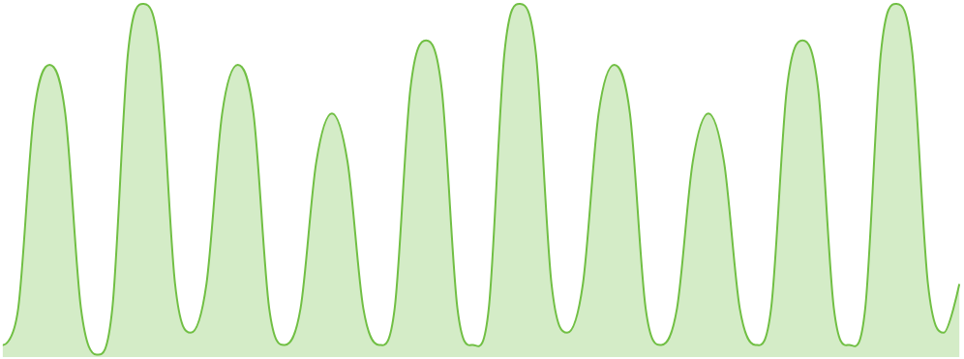
Effort Requirements for Data Quality
Data Cleaning
Effort Required
Time
Data Quality
Effort Required
Time
Improving data quality upfront reduces ongoing effort and resource requirements

Slide 9
Roles and Responsibility
Immediate Data User
Data Manager
Subject Matter Expert
Needs: Able to create solutions and work with data that meets their needs
Needs: Empowered staff who can work with and trust the data they require
Needs: Users who can be self-sufficient when learning about their data
Responsible for: Providing insight to the Data Quality team on how they use the data
Responsible for: Prioritizing data quality and determining quality objectives
Responsible for: Describing information and business rules related to data
Downstream Data User
Data Analyst
Data Quality Analyst
Needs: Able to use products and solutions that are built with trusted data
Needs: Clear understanding of data profile and data quality success markers
Needs: Coordination from the data team to understand needs, and resources available
Responsible for: Providing insight to the Data Quality team on how they use the data
Responsible for: Strategies for quality improvements and dashboard development
Responsible for: Facilitating several steps in the Data Quality Assessment

Slide 10
Data Stewardship
Data Steward
Who: The person who ensures the fitness of purpose for the organization’s need
Needs: Empowerment from management, active communication with data consumers
Responsible For: Metadata capture and maintenance, conversations with data producers and users, documentation of issues, quality improvement strategies, quality monitoring

Slide 11
Step 2 – Fit For Purpose
Notes:
Title:
Font: Tw Cen MT Condensed
Font size: 60

Slide 12
Data Quality should be Fit for it’s Purpose
Who should determine the data quality level required? Data Creators, Data Consumers, someone else?
Data Consumers! Data Quality is defined at the point the data is used
Keep in mind:
Who are the data users?
What are their use cases?
Are there reports, dashboards, products or systems relying on this data?
What are the consequences of poor-quality data?
Notes:
Data Consumers are often Data Producers too, and often the most important consumer of the data is by the person who produces it. How do I as a data Steward find this out? What about in reverse?

Slide 13
Case Study: Winter Road Maintenance
Public Works maintains a layer indicating salted roads, with details on timing and salt quantity
Public Works use this data for operational monitoring and planning out future road salting
Legal also utilizes this data for insurance purposes, as evidence of the Region's compliance with safety requirements
Who should determine the quality of this data?
Both groups!

Slide 14
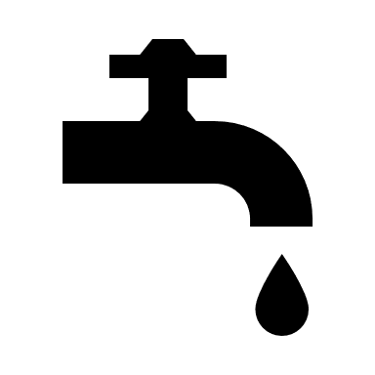
Data as a Flow – Employment Survey
Econ
Annual State of Economy Report
Econ
Economic Development Staff
Econ
Econ
Econ
Employment
Survey Staff
Employment
Survey Database
Employment
Forecasting
Long Range Planning Staff
Econ
Land Needs Forecasting
Econ
Econ
MPAC Survey
Data
Employment
Survey Report
Water/Wastewater
Engineers
Econ
Source Water Forecasting
Econ
Econ
Region Addresses
and Roads
Business Directory
Products
Econ
Market Analysis Reports
Labour Market Analysts
Consumers
Econ
Econ
Econ
Local EcDev
Agencies
Open Data
Training Needs
Marketing Companies
Real Estate
Agents
Econ
…And Many More
Data Sources
Data Systems
Data Consumers
Data Products

Slide 15
Step 3 – Trust in Data
Notes:
Title:
Font: Tw Cen MT Condensed
Font size: 60

Slide 16
Trusting Data Example
How do Data Consumers in the Employment Survey example know the data can be trusted?
What issues arise if Data Consumers cannot determine if data is trustworthy?
Communication and feedback are vital to a Data Quality initiative

Slide 17
Data Users Trust
I don’t know how good this data is
I know the quality of this data
I know the data quality will remain strong
I’m not sure what these fields mean
I understand the metadata
Data changes will be communicated to me
I’m going to check with other data
I can use this data without evaluating it
My concerns with the data are being heard
Low Trust
High Trust
Notes:
Trust is earned over time and lost in an instant. Taking the time to constantly rebuild trust is damaging.

Slide 18
Subjective vs Objective Measures
There are two types of ratings: Subjective and Objective
Subjective: Ranked against a scale.
High Medium Low
Thumbs Up Thumbs Down
Satisfied Very Satisfied etc.
Objective: Based on measurable component of the data
% of records with value in the Name field
% of records matching domain
Count of of duplicate values in a table
Which would you rather use to communicate Data Quality?

Slide 19
Step 4 – Dimensions of Data Quality
Notes:
Title:
Font: Tw Cen MT Condensed
Font size: 60

Slide 20
What are Quality Dimensions?
To determine if a table meets quality standards, we measure its dimensions
Just like we have dimensions of physical items, we have dimensions of Data Quality
Measuring those dimensions allows us to tell if the Data meets quality standards

Slide 21
5 Dimensions of Data Quality
Timeliness
Is the data available when
you need it? How long after
the real-life event has occurred is
data available?
Completeness
Does all the data exist, and are all required attributes populated for each field?
Validity
Does the value conform
to the business rules? Does
the data match the domains?
Integrity
Are cross table relationships
working? Are there any
duplicate records?
Consistency
Are the data consistent with
the rest of the data in the
table?
Notes:
There is a sixth dimension, Accuracy! How accurate is the data to the real life phenomena. However, we leave that our here, since as a region that is less relevant, we can’t exactly go out and scan our real life assets to even compare.

Slide 22
Step 5 – Sources of Anomalies
Notes:
Title:
Font: Tw Cen MT Condensed
Font size: 60

Slide 23
Sources of Anomaly Exercise
Exercise: For each Dimension of Data Quality, what sources of anomaly might exist?
How would you prevent those anomalies from occurring?

Slide 24
Anomaly Exercise: Completeness
Example 1
Problem: Incomplete records
Source of Anomaly: User accidently skipped field in survey
Mitigation Strategy: Enforce mandatory fields in field app
Example 2
Problem: Missing records
Source of Anomaly: Data dropped in processing
Mitigation Strategy: Confirm record count at beginning and end of ETL
Completeness
Does all the data exist, and are all the required attributes populated for each field?
Notes:
ETL is an Extract Transform Load process, and is often how data moves from one location to another, or is combined with other data.

Slide 25
Anomaly Exercise: Timeliness
Example 1
Problem: Data not updated frequently enough
Source of Anomaly: ETL runs weekly
Mitigation Strategy: Increase scheduling of ETL process
Example 2
Problem: Data takes too long to process
Source of Anomaly: ETL process cannot finish all input data within the time required
Mitigation Strategy: Improve processing capabilities of machine running ETL
Timeliness
Is the data available when you need it? How long after the real-life event has occurred is data available?

Slide 26
Sources of anomaly Exercise: Validity
Example 1
Problem: Extraneous municipality names in business directory
Source of Anomaly: User typo when entering names in survey
Mitigation Strategy: Pick list of municipalities
Example 2
Problem: Summarizations of data reveal incorrect values
Source of Anomaly: Incorrect logic
Mitigation Strategy: Warning when roll up value is illogical
Validity
Does the value conform to the business rules? Does the data match the domain?

Slide 27
Anomaly Exercise: Consistency
Example 1
Problem: Outlier values skew results
Source of Anomaly: Data entry anomaly
Mitigation Strategy: Flag outlier values and alert steward of potential problem
Example 2
Problem: Dramatic increase in values where data rarely changes
Source of Anomaly: New user misunderstood data entry form
Mitigation Strategy: Improved training resources
Consistency
Are the data consistent with the rest of the data in the table?

Slide 28
Anomaly Exercise: Integrity
Example 1
Problem: Duplicate value blocks many to one relationships
Source of Anomaly: Multiple users create entries for same phenomena
Mitigation Strategy: Block duplicates from being created
Example 2
Problem: Orphan record in child table
Source of Anomaly: Foreign key in child table record does not exist in parent
Mitigation Strategy: Confirm foreign keys existence in parent table before saving
Integrity
Are cross table relationships working? Are there any duplicate records?

Slide 29
Data Profiling
To know if there is a problem, you first must understand the data itself
How can you measure if the cross-table relationships are valid, without knowing the cross-table relationships are?
Data profiling is the exercise of discovering and characterizing the important features of a dataset.
Notes:
Imagine reading a profile of a famous person in the newspaper, you might learn a bit about them, or what they do, based on someone examining them a bit. The data structure, content, rules, relationships including: data types, field lengths, cardinality of columns, granularity, value sets, format patterns, content patterns, implied rules, cross-column and cross-file relationships and their cardinality

Slide 30
Step 6 – Critical Fields
Notes:
Title:
Font: Tw Cen MT Condensed
Font size: 60

Slide 31
What are Critical Data Elements?
The elements of the data most important to the end user
Imagine a new customer for your tables arrives, “it’s crucial to me that the tables are exactly 150.45 cm tall.”
Would you change your quality assessment based on the new information?
How would you know the end users needs without asking them?

Slide 32
Critical Data Elements can be different for each user
In the Employment Survey example, we have 7 unique data products from the 1 data source.
Users have different interests from the data, and so the fields they deem critical may be different.
The most critical fields are the most widely used fields

Slide 33
Taking Risk into Consideration
Strong data quality can be difficult to maintain. How can we prioritize the data to measure? Focus on two areas:
Critical Data: Focus on data that data users identify as the most important for their work
At Risk Data: Profile data that is prone to anomaly or change most frequently.
The most important data to measure is critical, at risk, data
All Data
Critical
Data
At Risk
Data
Different users may have different critical data elements for the same data

Slide 34
Step 7 – Target Setting and Monitoring
Notes:
Title:
Font: Tw Cen MT Condensed
Font size: 60

Slide 35
How Do We Set Targets?
Imagine the following cost to quality estimates
Quality Target | Cost to Achieve
99.5% | 100,000$
99% | 50,000$
98% | 10,000$
95% | 500$
90% | 0$
What target should we set?
What additional information would you want to help decide?

Slide 36
Why Not 100%?
90% Data Quality
Original Dataset
After Cleaning
Missed Deadline
95% Data Quality
Notes:
Planning example
They need these fields entered correctly, if it’s wrong it costs them time to fix the anomalies on submissions
But, as long as less than 5% of entries have an anomaly, they can fix everything without getting overwhelmed
So 95% is fine! What is FINE for your team
Goals change, deadlines change reass what is fine if the world moves
50 development submissions are entered each month, with a 30 day turnaround time.
If 48 of them are anomaly free, planning will have time to complete the anomaly free submissions, and fix the 2 problem submissions, and meet their targets
However, 3 or more will cause delays, and miss their targets.
Target is 95%, anything higher is great

Slide 37
Target Setting with Users
Often the higher the target, the more expensive the requirements.
Work with users to identify meaningful targets that ensure data is fit for purpose
The gap between current state and target state is the work required
Targets can be unique per dimension or field
Check with data steward to confirm target is possible!

Slide 38
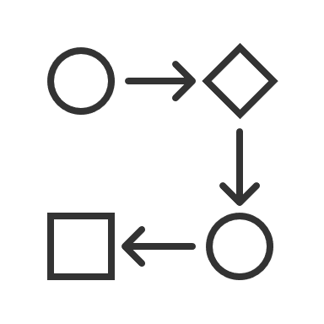
Establish Process
On-going Monitoring
Visuals and dashboards can make monitoring easier. By creating visual indicators based on our success measures.
Periodic checking of quality dashboards can show patterns in quality, and compared to the data flow can show what impacts data quality.
1
2
Corrective Action
4
3
Quality Warning Alert
Based on the metric that has a quality warning, understand what went wrong, and implement a new solution to stop future problems, and clean data to make up for anomalies made.
When any quality measure falls below our agreed upon success metric, data quality steward should be notified immediately.

Slide 39
Step 8 – Data Quality Assessment Procedure
Notes:
Title:
Font: Tw Cen MT Condensed
Font size: 60

Slide 40
Four Steps of Data Quality Assessment
Understanding the Data
Profiling, and Identifying Critical Fields
Assessing Fit for Purpose
Improving, and Monitoring Data

Slide 41
Case Study: Daycare Database
A health department maintains a daycare database. At the beginning of each month a staff member calls every daycare they know about and asks how many open spots are available.
The staff member writes the answers on a piece of paper while on the phone, and later checks to see if number of vacant spots is different in the database. If it is, she updates the available spots number. The dataset is posted to a website after she has called all the daycares.
On March 20th an irate citizen calls, she drove to the address where the daycare was supposed to be but couldn’t find it. Once home, she called the daycare, but no spots were available.

Slide 42
Step 1: Understanding the Data
1A: Identify Data Assessment Project
Completed by: Business Unit Manager
Purpose: The team reaches agreement on the objectives of the quality assessment
Output: Approved Project Charter
Step 1:
1B: Gather Existing Documentation
Understanding the Data
Completed by: Data Quality Steward
Purpose: Avoid duplication past data design work
Output: Avoid duplication of documentation that may already exist
1C: Initial Dataset Assessment
Completed by: Data Quality Analyst
Purpose: Understand how the data is used, and user’s concerns
Output: Updated documentation, SIPOC Diagram, Terms, Lifecycle Analysis, Initial Quality Expectations

Slide 43
Who supplies the data?
Who processes the data, and how is that done?
Who is using the data and in what form?
What expectations of data quality might our end user have?
How is feedback from data users incorporated into the lifecycle?
Notes:
CLICK ON THE RIGHT SIDE

Slide 44
Step 2: Profiling, and Identifying Critical Fields
2A: Profiling
Completed by: Data Quality Analyst
Purpose: Look at data elements and relationship integrity, interpret results to create current condition report.
Output: Field-level data analysis, machine-detected business rules suggestions
Step 2:
2B: Individual Data Attributes
Completed by: Data Quality Analyst
Profiling, and Identifying Critical Fields
Purpose: Work with data users to determine which data elements are critical
Output: List of critical data fields in the dataset
2C: Understanding Processing
Completed by: Data Quality Analyst
Purpose: Understand how the system processes critical data.
Output: Information on how critical data fields are processed

Slide 45
Case Study: Daycare Table
Daycare name | Infants | Infant Currently available | Toddlers | Toddlers Currently available | Preschool | Preschool Currently available | Address | Municipality | Number of daycare workers | Sq. m | Certification | Regular Hours
Kiddie Korner | 10 | 3 | 12 | 0 | 22 | 3 | 4 Pinnacle Trail | Aurora | 10 | 80m² | Yes | 8-6
Stepping-Stone Preschool | 0 | 0 | 15 | 1 | 24 | 2 | 9550 Pine Valley Dr | Klineberg | 7 | 93m² | Yes | 8:30-5:30
Children's Den | 10 | 2 | 15 | 1 | 28 | 6 | 216 Main Street Unionville | Unionville | 11 |  | Yes | 7.30-6
Kiddie Korner | 10 | 2 | 12 | 4 | 22 | 2 | 4 Pinnacle Trail | Aurora | 10 | 80m² | Yes | 8-6

Slide 46
Case Study: Data Quality Assessment Step 2
From what you can see, what can you tell about the: Field Types, Field Relationships, Table Relationship Integrity, Existing Business Rules
Imagine you are a Data User, which fields do you think are critical? Why?

Slide 47
Step 3: Assessing Fit for Purpose
3A: Assess Profile Results
Completed by: Data Quality Analyst
Purpose: Develop concise summary of current condition of the dataset
Output: Profile results analysis
Step 3:
Assessing Fit for Purpose
3B: Assess Fit to Purpose
Completed by: Data Quality Analyst
Purpose: Review the current condition report with users to establish how good data needs to be to meet their needs
Output: Data quality targets for critical data fields, Baseline quality assessment

Slide 48
Case Study: Data Quality Assessment Step 3
What data quality issues can you see in the table?
Are there data quality issues in the described data flow?
Is this data fit for purpose?

Slide 49
Step 4: Data Improvements and Monitoring
4A: Develop Data Improvement Recommendations
Completed by: Data Quality Steward
Purpose: Create strategies that address the gaps between current condition and desired state
Output: Recommendations on how to improve quality with measurement specifications
4B: Document Data Quality Improvement Plan
Completed by: Data Quality Analyst
Purpose: Prioritize improvement goals with stakeholders, and create action plan to improve and monitor datasets
Step 4:
Output: Data Quality improvement plan
Improving, and Monitoring Data
4C: Improvement Project Initiation and Actions
Completed by: Business Unit Manager + Data Quality Steward
Purpose: Initiate and implement improvement projects and actions, and educate staff involved
Output: Tangible improvements to data, Queries to measure aspects of data quality
4D: On-Going Maintenance
Completed by: Data Quality Steward
Purpose: Ensure quality targets and being met and intervene when quality falls below established targets
Output: Periodic status reports on data quality, which include lists of anomalies and discrepancies

Slide 50
Case Study: Data Quality Assessment Step 4
What recommendations would you make to solve our identified data quality problems?
What metrics would you look for to make sure the data quality remains strong?

Slide 51
Case Study – Public Health
Notes:
Title:
Font: Tw Cen MT Condensed
Font size: 60

Slide 52
The Problem
York Region’s Public Health unit had a data quality problem, and spent hundreds of hours on data cleaning
After the COVID-19 Pandemic there was a renewed effort to increase the data quality throughout the team
Needed a solution that fit their people and culture for complete buy in

Slide 53
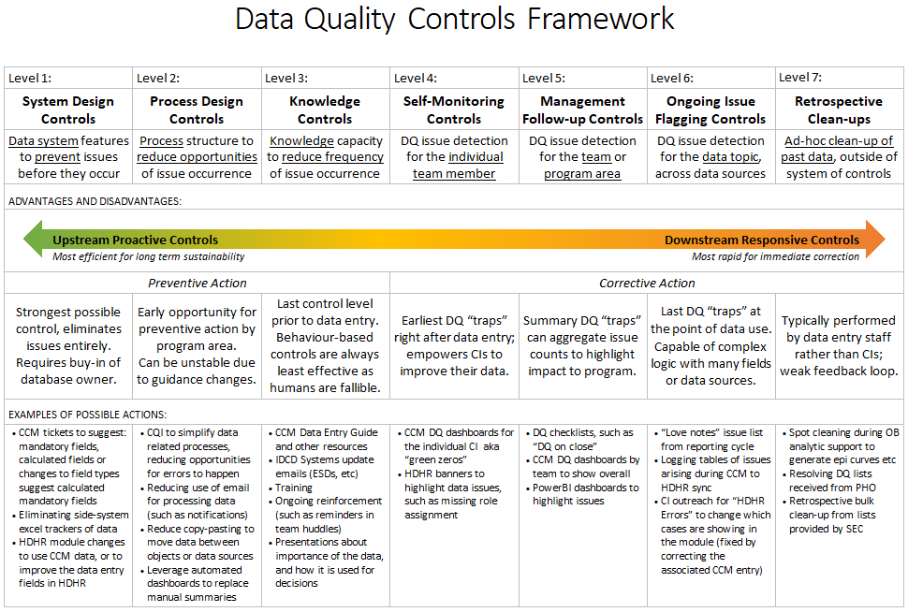
Tailoring Data Quality to their Group

Slide 54
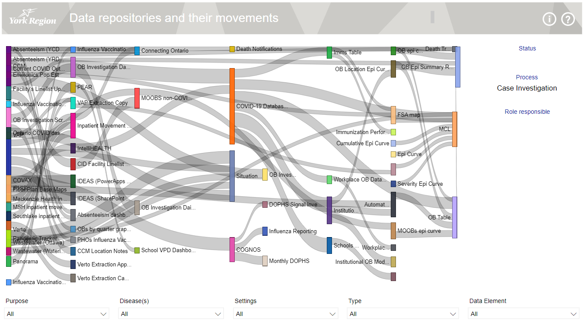
Understanding the Lineage of CHS Data
Lineage diagrams show where data came from, and where it goes to. This diagram was created in Power BI to show how data moved through each system.
Notes:
Click in the new page not spreadsheet.

Slide 55
Conclusion
Notes:
Title:
Font: Tw Cen MT Condensed
Font size: 60

Slide 56
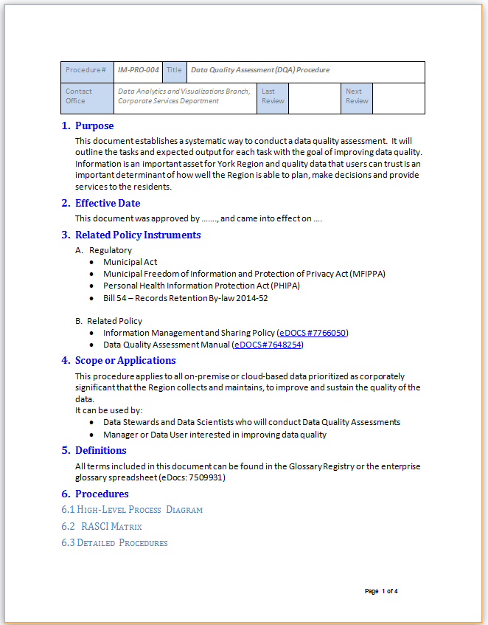
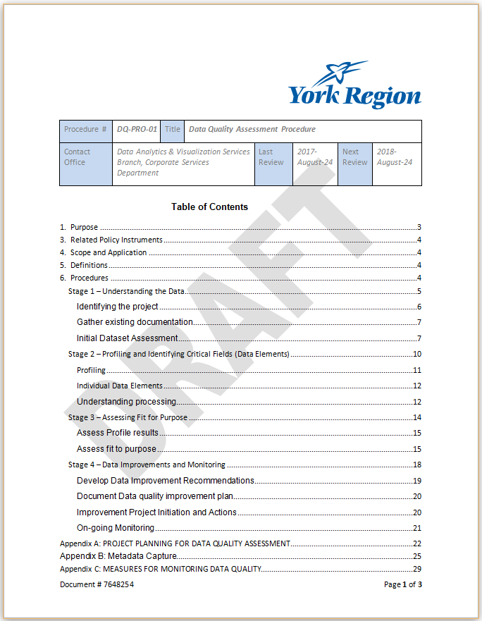
Additional Resources
Data Quality Assessment Procedure
eDOCS #8353186
Data Quality Assessment Manual
eDOCS #7648254
Notes:
Here are some resources – you may want to make note of these eDocs numbers
The first is the Data Quality Assessment Procedure (9 page document)
The second is the Data Quality Assessment Manual – quite an extensive document, much more detailed – contains reference material
PUT LINK TO COURSE SURVEY IN CHAT

Slide 57
Next Steps
Think about how you can incorporate Data Quality into the data you work with
How can you get buy in from your data team?
What are the little changes you can make that lead to big differences?

Slide 58
THANK YOU!

